Slide 1
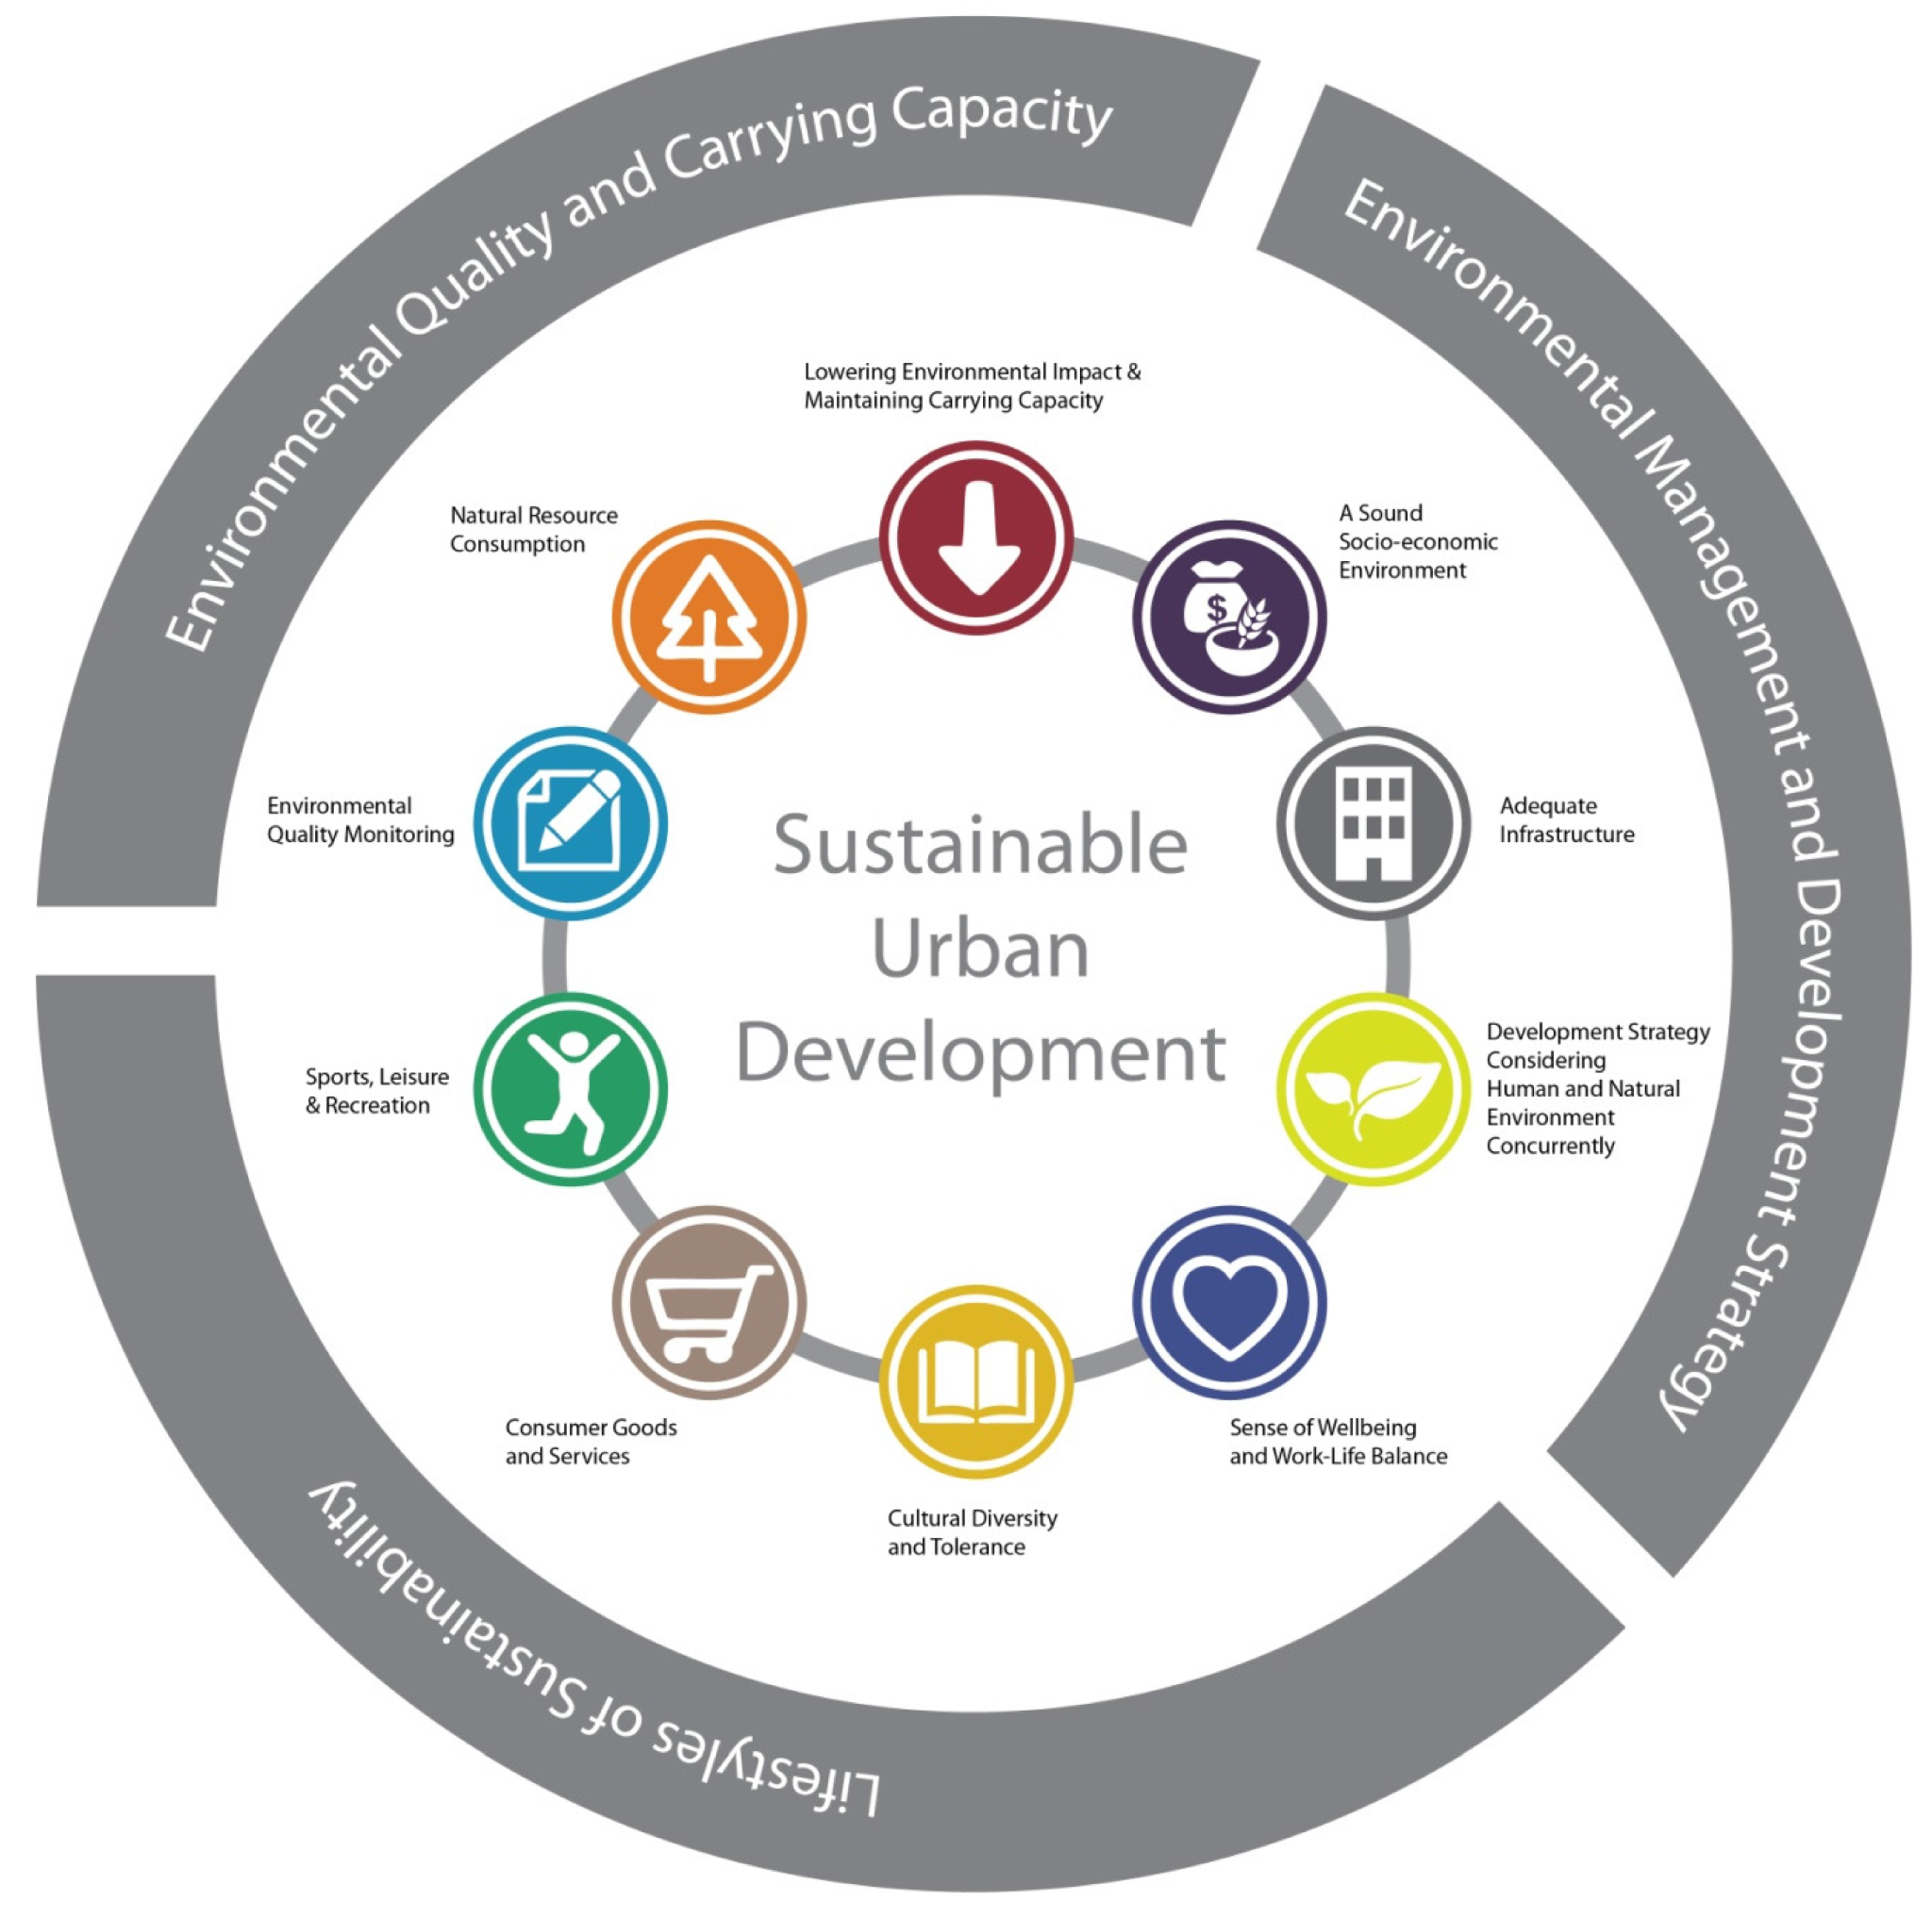
Sustainability, Climate and Urban Development: E - Vehicles and Environmental Governance
By: Group-26
Rahul Agrawal - 2020456
Rahul Bansal - 2020457
Samar Preet Singh - 2020464
Kanishk Singh - 2018044

Slide 2
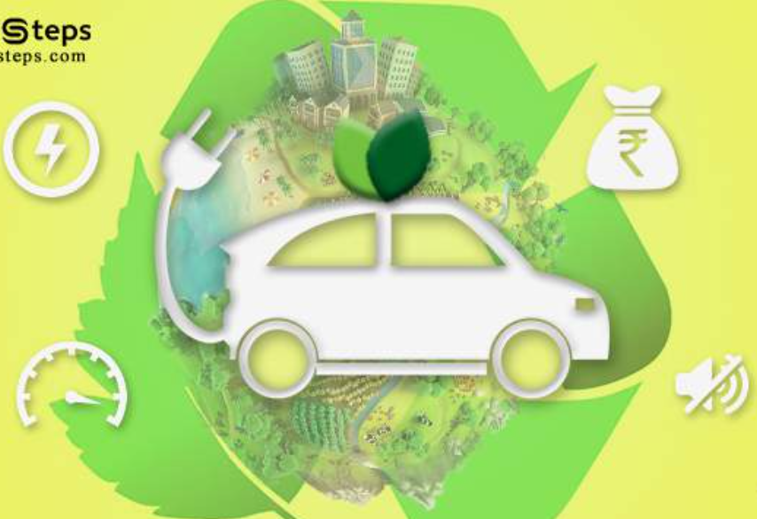
CONTEXT
Urban sustainable development is a collective concept that underpins within it the individual wellbeing. It is important to meet the needs of the present generation, especially the poor, keeping in mind the environment’s ability to meet the needs of the future.
India successfully balances modernity with its rich cultural history while minimizing its negative environmental effects. However, it also seems like smart governance or technical advancements by themselves might not be sufficient to resolve the core issue that environmental governance must tackle

Slide 3
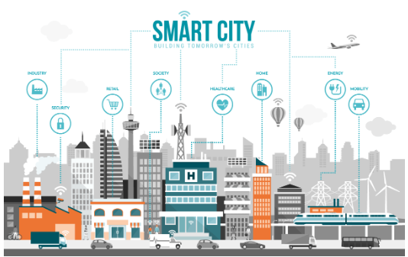
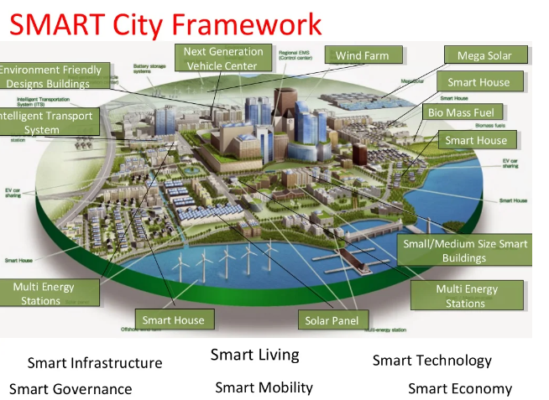
Now
Let us explore in the next slide whether Delhi is a smart city or not .
It has been six years since the launch of the Smart City Mission in 2016. Yet its core idea, of creating a participatory model for urban governance, remains elusive. Especially for the urban poor.
A Special Purpose Vehicle (SPV), namely NDMC Smart City Ltd. (NDMC SCL), has been incorporated on 28th July, 2016 with equity contribution from Government of India (Gol) and NDMC. Total 106 projects envisaged under Smart City Mission and out of these, 86 have been completed. This includes projects like waste management , water management , tackling environmental concerns and these projects plan to achieve sustainable development of delhi

Slide 4
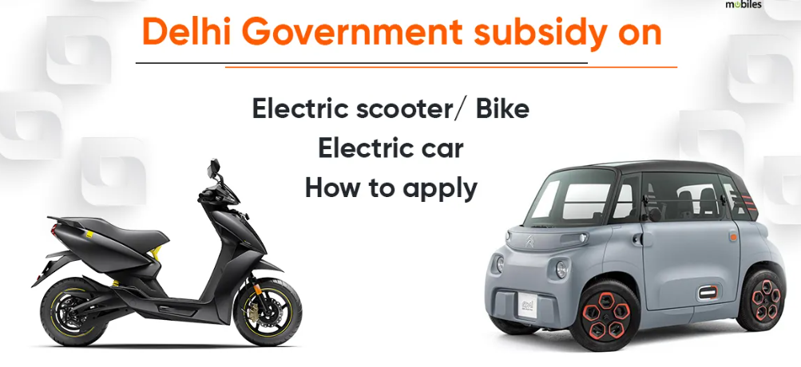
ELECTRIC VEHICLES
E-Vehicles in Delhi
According to Delhi government website EV Delhi, the electric vehicle policy aims to have one out of every four vehicles sold in Delhi by 2024 to be an EV. The EV policy directs funding through sources like pollution cess, road tax, congestion tax environment compensation charge, the Delhi government website read.
The shift toward electric vehicles isn’t just focused on cars. Two- and three-wheelers make up 75% of all vehicles in Delhi, and the Delhi EV Policy includes incentives for e-bikes and e-rickshaws.
They eliminate tailpipe emissions, reduce dependence on fossil fuels, improve community health, safeguard energy security, and improve prospects for employment and upskilling.
Thus this helps in achieving a sustainable development and is also environment friendly

Slide 5
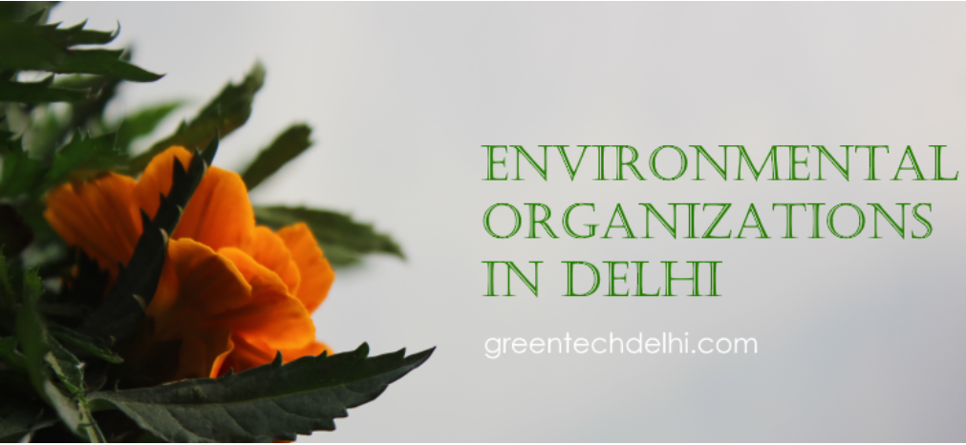
Environmental governance of delhi
The Department of Environment, Govt. of NCT Delhi has the responsibility of improving the Environmental Quality in Delhi.The Department is actively engaged in assessment, monitoring & protection of environment, pollution monitoring and control, enhancement of green cover, Climate Changes and related issues
ENVIRONMENT VISION AND MISSION:
Policy making towards pollution control.
Promoting various programs to make Delhi, Clean, Green and Pollution free
Organizing tree plantation programs in schools, residential areas, parks, industrial areas etc.
The perspectives of sustainable urban planning include a good environment and social capital and these concepts shall be incorporated in the planning process.

Slide 6
Questions
Urbanization
Is Delhi livable and safe?
To achieve sustainable growth, Delhi must become more livable and safe, with clean air, adequate infrastructure, reliable utilities, and opportunities for learning and job creation.
The solution, therefore, lies in inclusive urbanization processes that prioritize the quality of life for all and focus mainly on the needs of disadvantaged urban groups in terms of employment, housing, sanitation, health care, and education.

Slide 7
Questions
2. Land
Is there enough land in Delhi?
Delhi has been experiencing one of the fastest urban expansions in the world.
Vast areas of croplands and grasslands are being turned into streets, buildings, and parking lots, attracting an unprecedented amount of new residents.
The geographic size of Delhi has almost doubled from 1989 to 2018, with the number of urban households doubling while the number of rural houses declined by half.
With a flourishing service economy, Delhi is a draw for migrants because it has one of India’s highest per capita incomes.

Slide 8
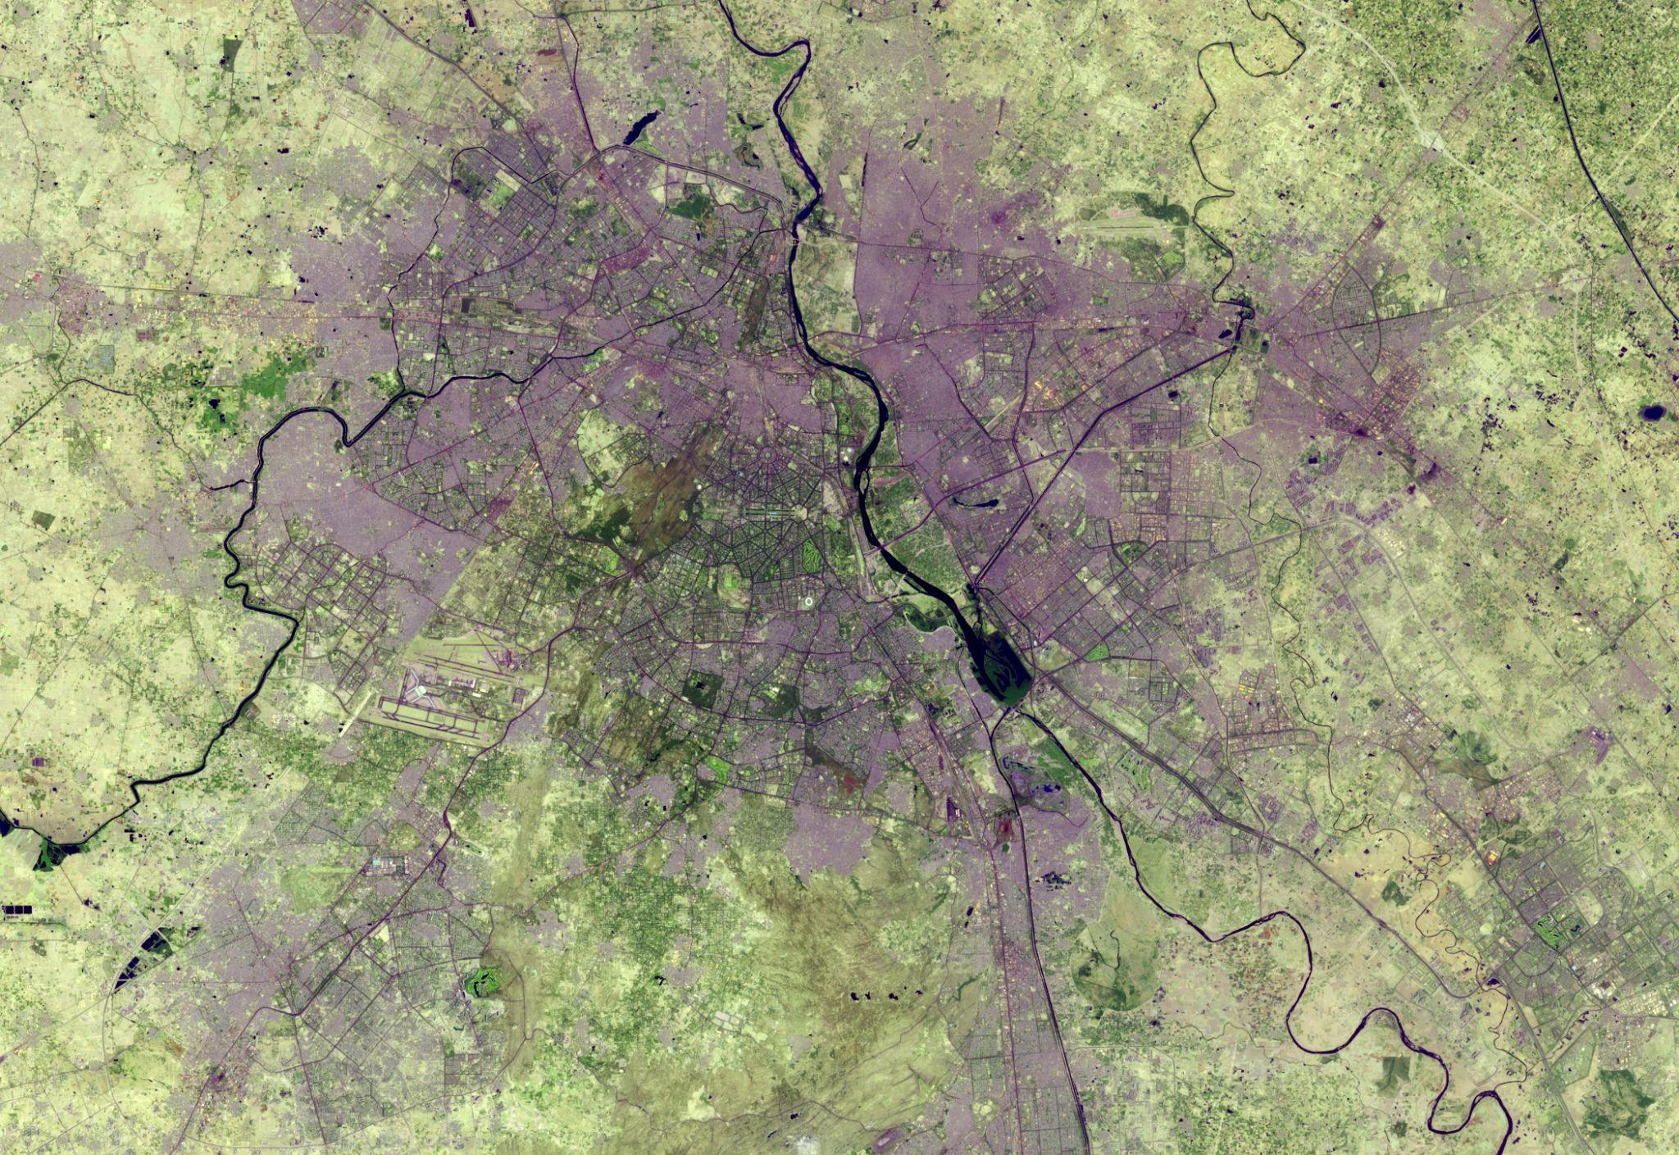
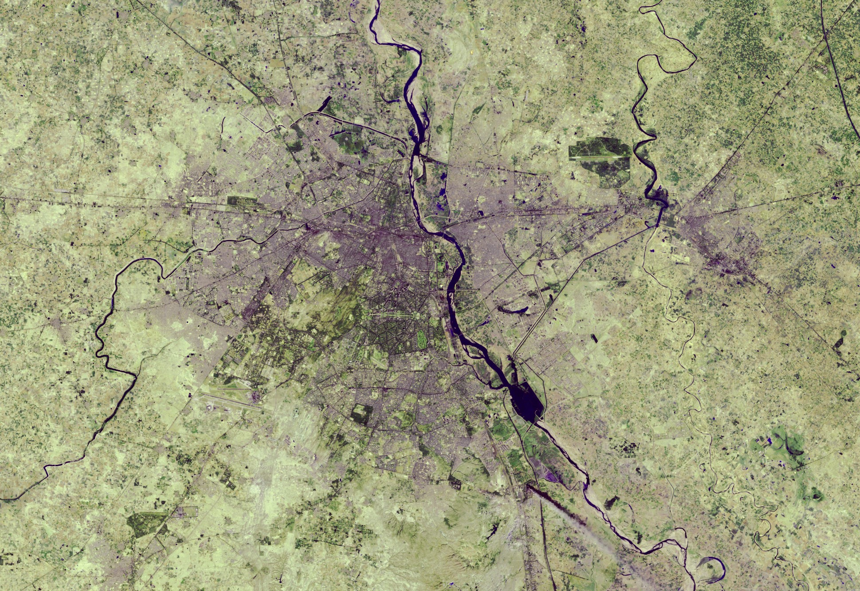
June 5, 2018 December 5, 1989

Slide 9
Questions
3. Water
Is there enough safe water?
The country’s water resources are decimating due to increasing water demand in agriculture, population growth, industrialization, and rapid urbanization.
The water quality of rivers and lakes is deteriorating due to the degradation of water flow.

Slide 10
Questions
4. Waste Management
Is the Waste Management System good?
Delhi produces 11144 Tonnes of waste per day.
The problem is more acute in the urban areas, where rapidly growing populations generate increasingly larger quantities of solid waste that urban local bodies (ULBs) cannot manage effectively. Improper management of solid waste poses risks to the environment and public health.

Slide 11
Questions
5. Are Electric Vehicles viable options?
Issues such as procurement cost, inadequate awareness of governmental incentives, battery range, taxation policies, and charging interoperability are mitigating against the adoption of EVs.
Even though EV maintenance is less expensive, the initial money needed to purchase an EV is relatively high.
Hence, EVs integration is faced with techno-economic and societal challenges, varying from infrastructural requirements to users doubts concerning EV price, charging time, non-ubiquity of EV charging stations , safety, reliability, distance range, maintenance service availability, and battery life durability.

Slide 12
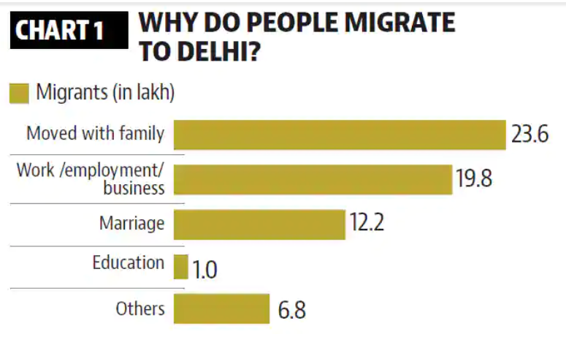
Methodology
Urbanization
1.)4 in 5 families in Delhi-NCR are affected by air pollution, shows a survey. Nearly 22 percent of the respondents said they or someone in their family have already visited doctors or hospitals regarding air pollution-related ailments.
2.)Among all states,Delhi has the highest share of inter-state migrants in its total population, an indicator of the attraction it holds for outsiders.

Slide 13
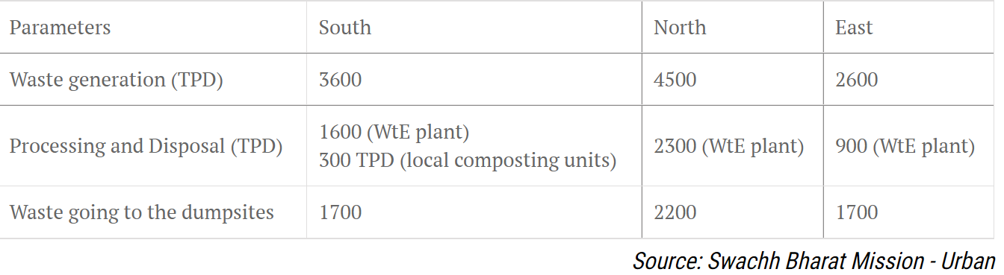
WASTE MANAGEMENT
Delhi generates about 8360 tons of municipal solid waste per day, and there is low compliance to rules regarding waste management. A stratified random sample, comprising 147 respondents, was chosen for a questionnaire survey,
Survey results indicate that 60% of residents do not know the difference between biodegradable and non-biodegradable waste, and only 2% of them segregate waste. Fifty-eight percent of respondents reported that the waste collector mixes the segregated waste, 97% of respondents reported that they sold items to an itinerant waste buyer, and 87% of households are covered by doorstep waste collection services.
The status of municipal waste generation in the three erstwhile corporations — now merged with the Municipal Corporation of Delhi — is given below:

Slide 14
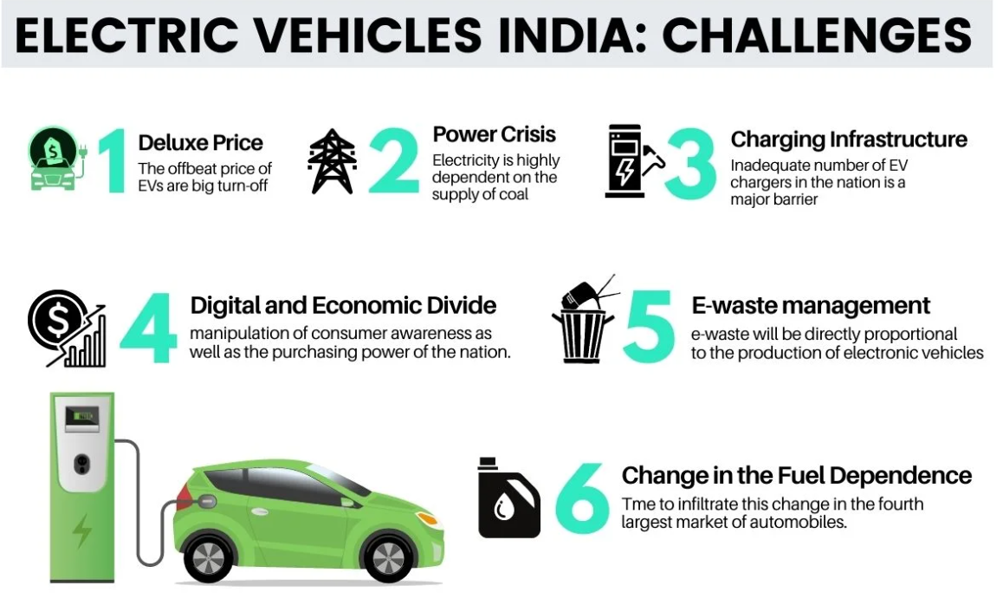
ELECTRIC VEHICLES VIABLE OPTION ?

Slide 15
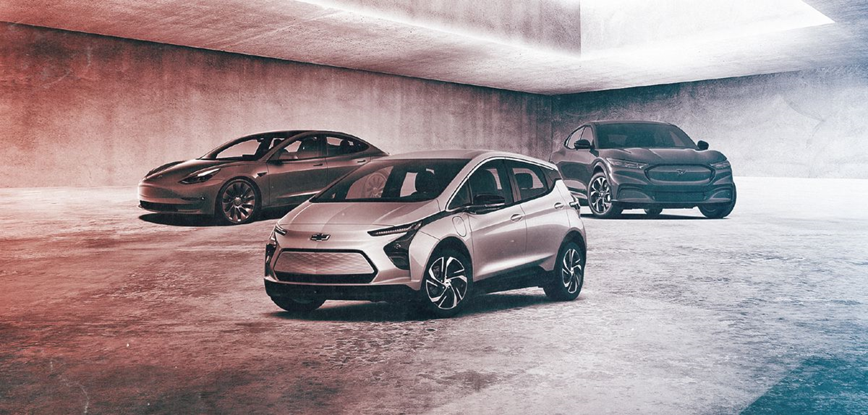
Electric Vehicles
Key analytical points
Pameter | Electric Vehicle | Conventional Vehicles
Energy | From electricity produced by battery | By Combustion of fuel
Pollution | Does not produce any harmful emissions | Produce harmful emissions
Running Cost | 1.5km | Diesel 4 to 4.5km, Petrol 6.5 And CNG 3 to 3.5

Slide 16
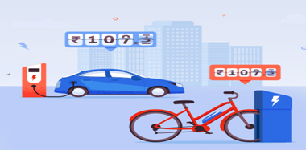
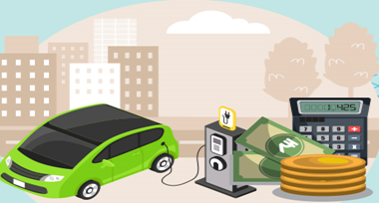
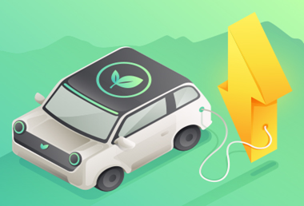
Benefits of Electric Vehicles
Lower Running Cost
Low maintenance cost
Zero Tailpipe Emissions

Slide 17
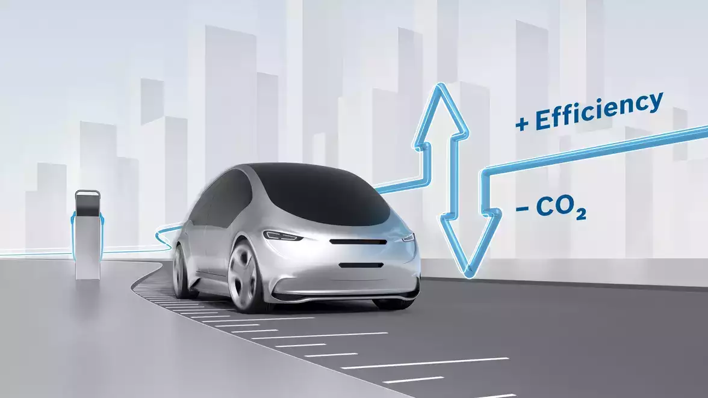
Environmental governance of Electric Vehicle
Indian government has taken a number of initiatives to combat the challenge of climate change to curb crude imports and high level of pollution in Indian cities.
Policy Initiatives by the Government
National Mission on Electric Mobility
Electricity Mobility Mission Plan 2020 ("EMP")
Automotive Mission Plan 2006-16 ("AMP-I")
Purpose emphasis to renewable energy sources, clean environment, and initiative coping with environment change. Which will generate significant additional employment and spur manufacturing

